Slide 2
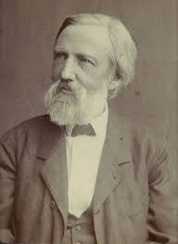
About the poet: Heinrich Hoffmann (June 13, 1809 – September 20, 1894) was a German psychiatrist, who also wrote some short works including Der Struwwelpeter, an illustrated book portraying children misbehaving. This is a poem from the book Struwwelpeter: Merry Tales and Funny Pictures published in 1845 in Germany.

Slide 3
In the title of the poem, the word ‘Fidgety’ means restless or uneasy. So this poem is about a boy named Philip who could not sit still at the dinner table.
The poet introduces Philip’s parents. He says that his father wants Fidgety to be a gentleman and throughout the poem we find him warning his son to behave properly. While on the other hand Fidgety’s mother is being portrayed as a very quite and serious parent.
In the poem we find that Fidgety being a restless child couldn’t control himself and he giggles and wriggles while having his meal on the dining table. Also, he was found rocking his chair back and forth like any rocking horse.
So, after watching patiently at Fidgety his father gets annoyed . Meanwhile, as Fidgety was rocking his chair he fell down and in order to get a support he pulled the table cloth . As he pulled it all the crockery which was kept on the table fell down and broke into pieces.
His parents were not able to see Philip as he was all covered with the table cloth. After watching all this incident Fidgety’s parents got quite annoyed and worried. In the end, Fidgety also realized his parents’s agony and concern because of his careless attitude.

Slide 13
Nithya Prakash /FACULTY/English/SNSACD

Slide 14
Nithya Prakash /FACULTY/English/SNSACD

